Slide 1
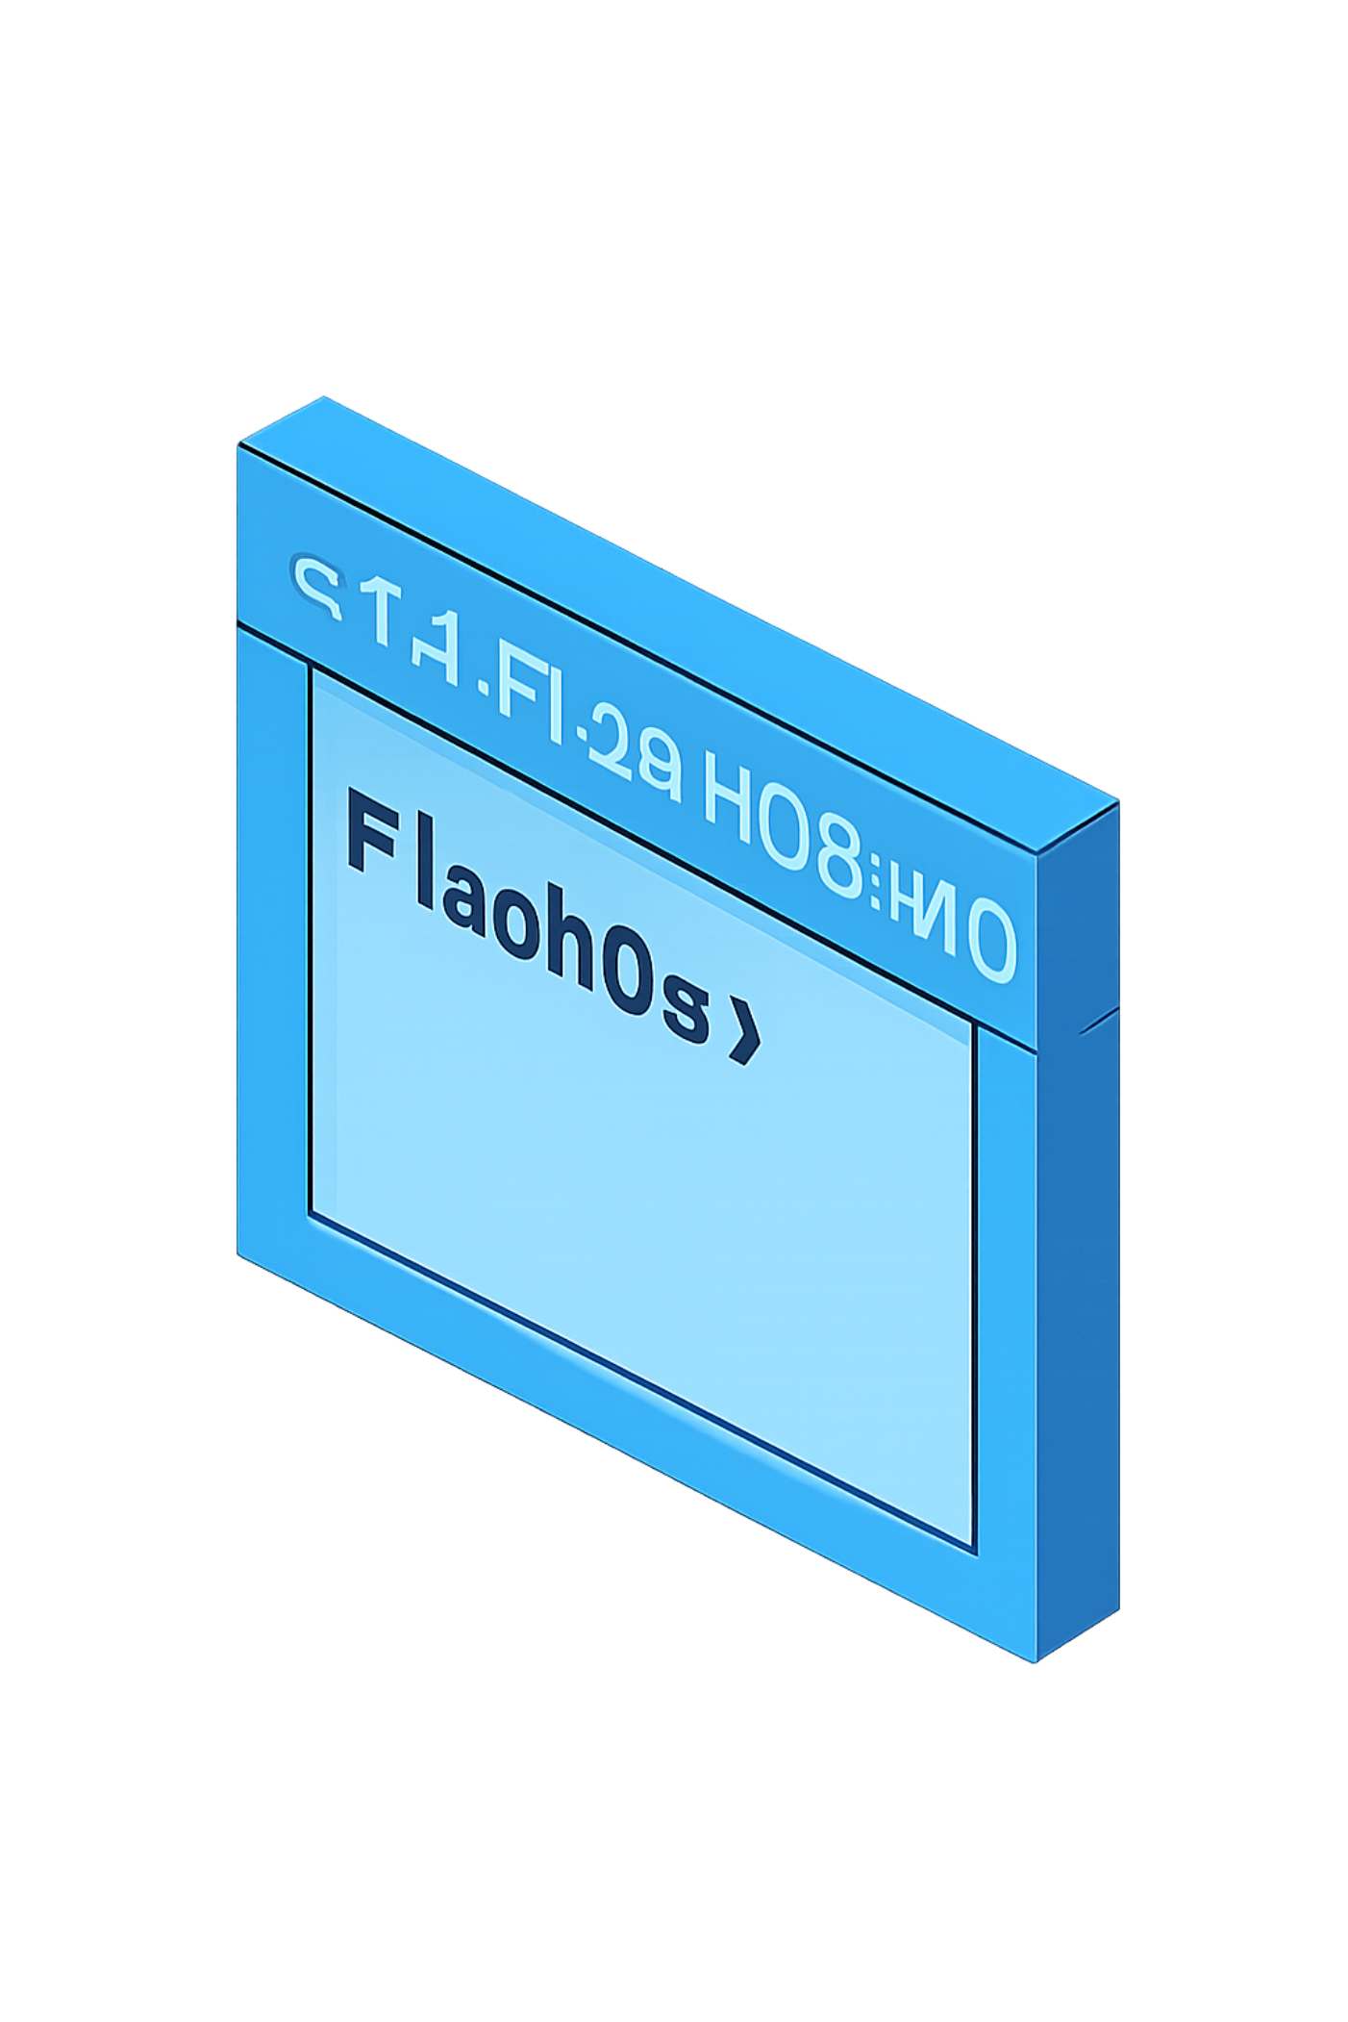
FLASHOS
Operating Systems Project
Subtitle: A Lightweight OS-Based Manual File Backup and Recovery System
Faculty: Dr. P Pavan Kumar · College / Department: KLH (Aziznagar)/ CSE department

Slide 2

Problem Statement
Users can accidentally delete, overwrite, or modify important files. Manual backup is inconvenient and often forgotten. There is a need for a simple command-line utility that lets users create backups and restore files when required.
Key point: Recovery is manual and controlled by the user.

Slide 3
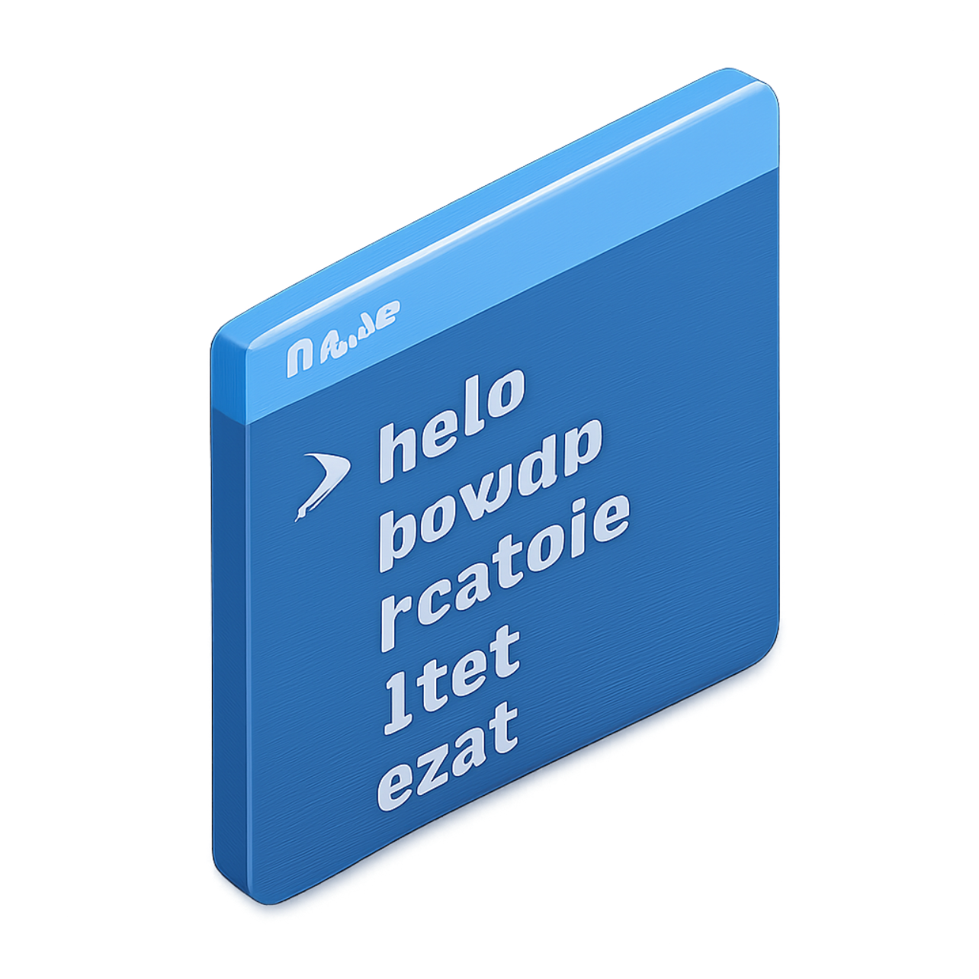
What is FlashOS?
FlashOS is a small Linux-based command-line file backup and recovery utility implemented in C. It demonstrates practical OS and Linux system programming using a focused file-management feature set.
Manual backup: user-initiated file copy to backup directory
List backups: view available backups
Manual restore: restore selected backup to original location
REPL interface: simple command loop (help, exit)
FlashOS is NOT a full OS — it is a teaching project that uses Linux system calls to implement file operations.

Slide 4


Current Implementation
Implemented Features
Backup & Restore
✓ FlashOS project structure
✓ C-based program
✓ REPL command interface
✓ Makefile & GCC compilation
✓ help & exit commands
✓ Manual file backup
✓ Backup listing
✓ Manual file restore
✓ Linux file I/O: open(), read(), write(), close()
Testing
✓ Functional testing using test.txt
✓ Verified basic workflows on Linux
All operations are explicitly initiated by the user (manual backup & manual restore).

Slide 5
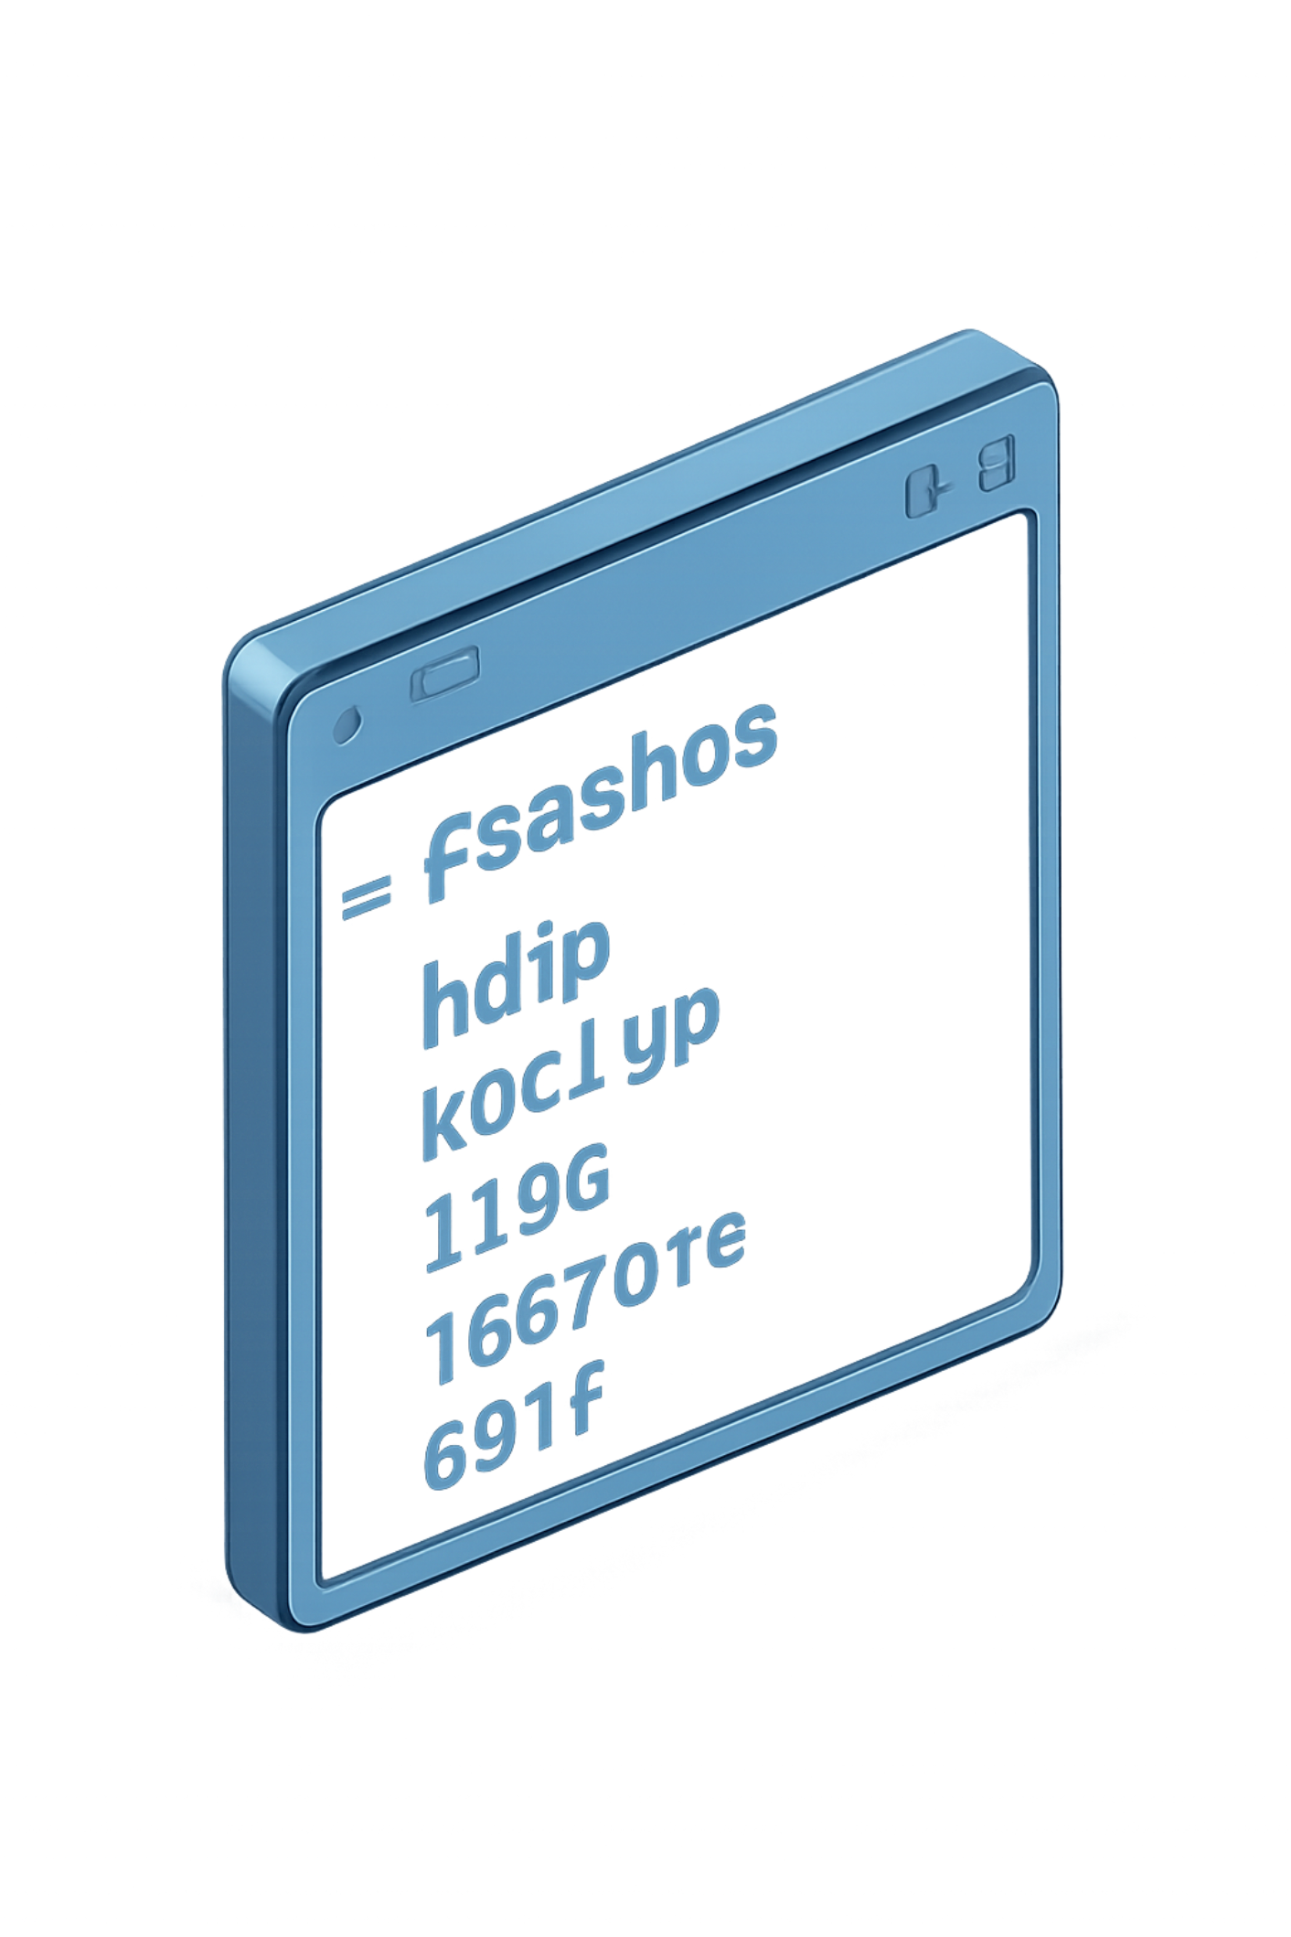
FlashOS — Working Demonstration
$ make
gcc -Wall -Wextra src/main.c -o flashos
$ ./flashos
============================ FlashOS v1.0 ============================
Type 'help' to see commands.
FlashOS> help
Available Commands: help backup restore list exit
FlashOS> backup test.txt
Backup successful: test.txt
FlashOS> list
Available Backups: test.txt
FlashOS> restore test.txt
Restore successful: test.txt
FlashOS> exit
Exiting FlashOS...
Highlight: All backup and restore actions are user-controlled.

Slide 6

Manual Backup Implementation
User Invokes Backup
FlashOS Opens File
read() Reads Bytes
write() Writes Backup
Implementation steps:
User issues: backup test.txt
FlashOS calls open() on source file
Read bytes via read()
Write bytes into backup/test.txt via write()
Close file descriptors with close()
Backup is manually initiated by the user; no automatic backup or automatic recovery is implemented.

Slide 7
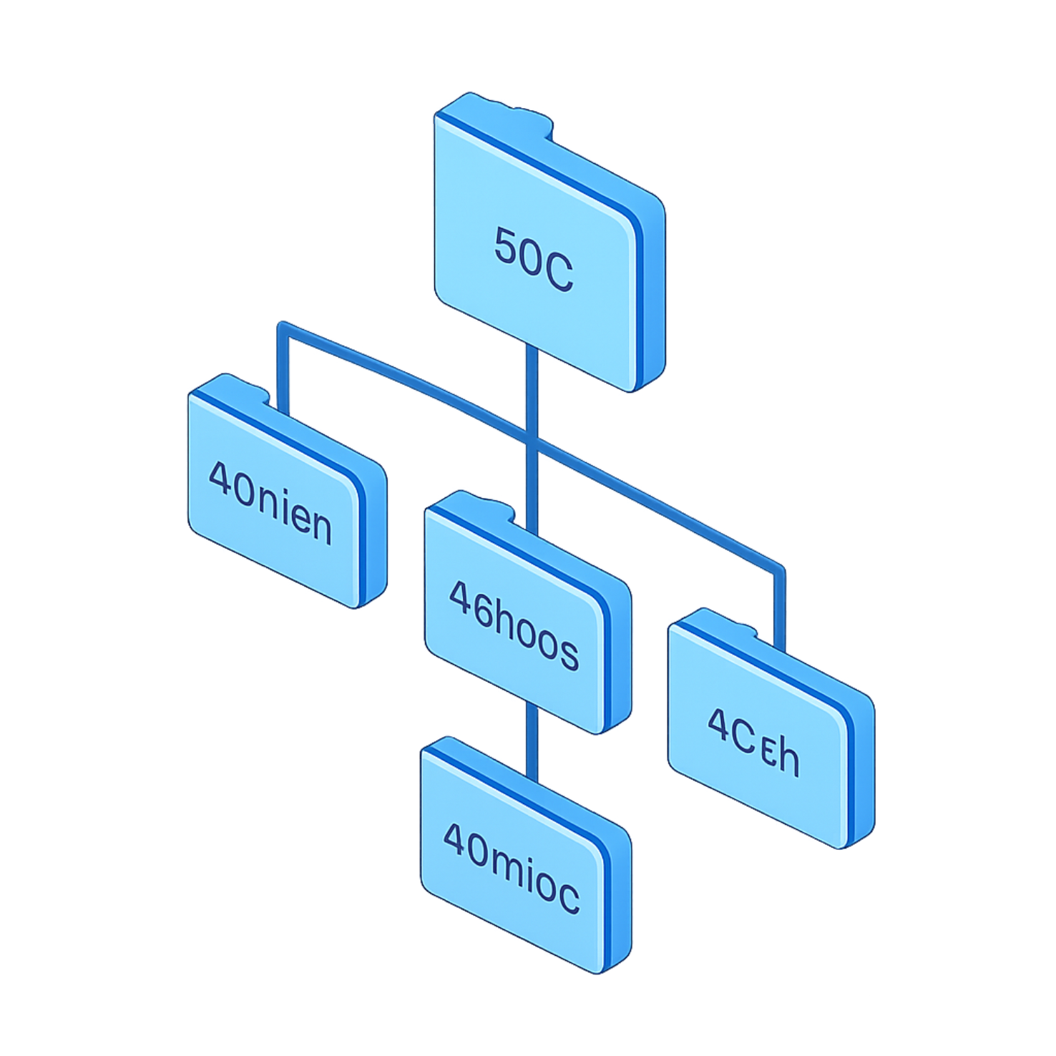
Project Structure & Build System
Repository layout:
FlashOS/
├── src/ (main.c)
├── include/ (headers reserved)
├── backup/ (stores manual backups)
├── docs/ (project documentation)
├── Makefile
└── flashos (compiled executable)
Build flow:
main.c → Makefile → GCC → flashos → ./flashos
Actual command:
$ make
gcc -Wall -Wextra src/main.c -o flashos

Slide 8


Faculty Evaluation Criteria
1
2
NOVELTY
ADAPTABILITY
FlashOS offers a lightweight, command-line approach for user-controlled manual backup and restoration.
Modular structure allows additional OS concepts to be added later as extensions (future work).
3
4
METHODOLOGY EVALUATION
DISSEMINATION & ACCESSIBILITY
Features validated through functional Linux execution: REPL, backup, list, restore, exit.
Implemented in standard C with Makefile and GCC — easy to build, run, and demonstrate.
Future OS concepts may be proposed, but are NOT implemented in the current prototype.

Slide 9


Current Project Status
COMPLETED
✓ FlashOS foundation · ✓ REPL interface · ✓ Makefile · ✓ Manual backup
✓ Backup listing · ✓ Manual restore · ✓ Linux file I/O · ✓ Basic functional testing
STATUS
Working Prototype
The current version demonstrates a Linux-based command-line environment implementing manual file backup and restore using core system calls.

Slide 10

Conclusion
Practical Tool
FlashOS provides a simple command-line environment for manual file backup and restoration.
Technical Foundations
The implementation is written in C and uses Linux file I/O system calls (open, read, write, close).
Educational Value
Project offers a practical foundation for learning Operating System and Linux system programming concepts.
Design Philosophy
Small system. Practical OS concepts. Step-by-step development. Future extensions may add advanced OS mechanisms (proposed only).
Thank You
FLASHOS — A Lightweight OS-Based Manual File Backup and Recovery System

Slide 11
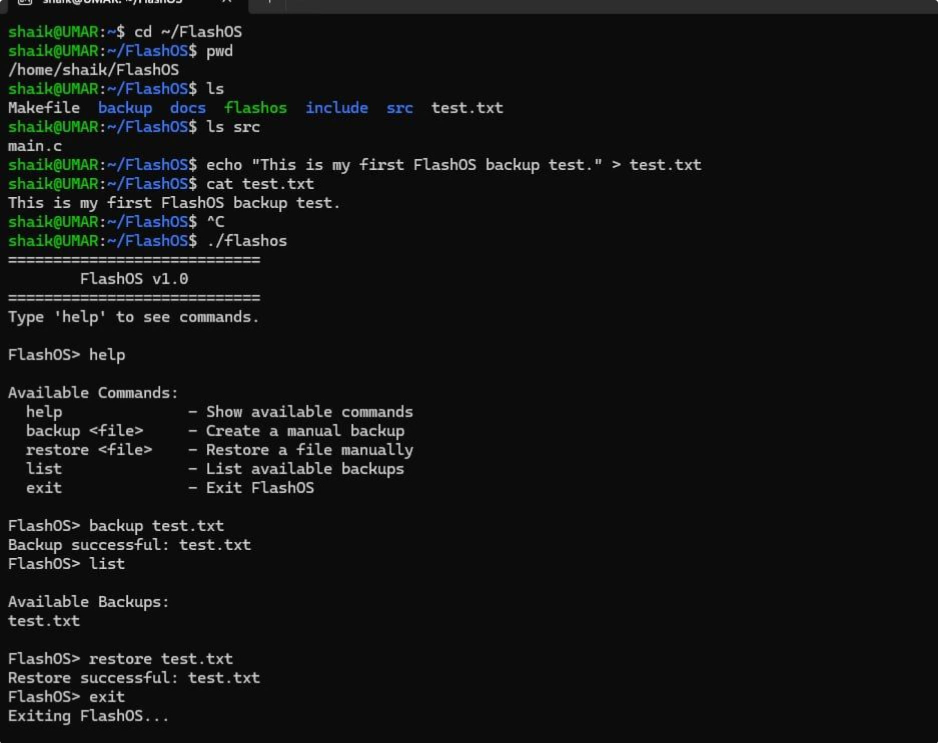
OUTPUT OF FLASHOS

